Slide 1
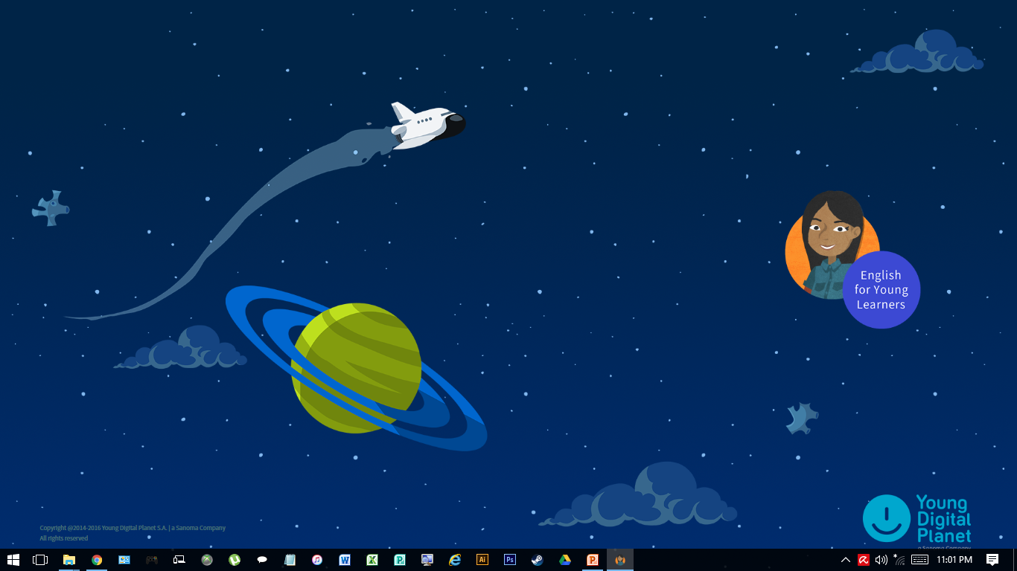
ENGLISH FOR YOUNG LEARNERS
CEFR-ALIGNED FORM 1 ENGLISH LANGUAGE
Fun, exciting and interactive!
Introduction to the resource CD
- - - - - - - - - - - - - - - - - - - - - - - - - - - - - - - - - - - - - - - - - - - - - - - - - - - - - - - - -
28 February 2017 @ Pasir Mas District Education Office
By Mdm. Wan Intan Adlina binti Wan Abdullah
SMK Baroh Pial, Rantau Panjang.
teacheradlina@gmail.com

Slide 2
You should have…
A User Guide booklet
An installation CD (with the activation code at the back of the container)
A User Guide CD (comprehensive lesson guide & teacher training modules)
A friendly note (Roles & responsibilities of parties involved)

Slide 3
You need…
Constant (and hopefully reliable) internet connection (especially for the Speech Recognition feature)
Up-to-date machine to run the contents
Enough computers for every student in your class or at least computer stations for them to take turns interacting with the contents (e.g the placement test, formative tests…)

Slide 4

"The (revised) curriculum emphasises the teaching centred on the students and focuses more on problem-solving, project-based assignments, updating subjects or themes and implementing formative assessments.“
Datuk Seri Mahdzir Khalid (2016)
(Source)

Slide 5
Usage Expectation
The first cohort: Form 1 students (2017)
At least once a week
Listed as “resource(s)” in daily lesson plan
Meant to…
Supplement the KSSM textbook, not replace it
Provide fun and meaningful enrichment activities
Introduce and encourage the Blended Learning Approach into teaching repertoire

Slide 6
Blended Learning Approach
A combination of e-learning with traditional classroom methods and independent study to create a new, hybrid teaching methodology
Primary Components:
In-person classroom activities facilitated by a trained educator.
Online learning materials, often including pre-recorded lectures given by that same instructor.
Structured independent study time guided by the material in the lectures and skills developed during the classroom experience.
(Source) / (Further Reading)

Slide 7
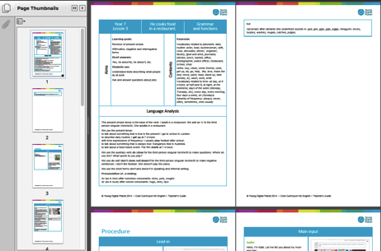
What’s in the CDs?
Installation/ Content CD
Placement Test
80 learning units
8 tests (1 test every 10 lessons)
Speech recognition exercises
User Guide
Printable PDFs (lesson guide)
Teacher training materials
(CLT, Blended Learning, etc)
Core Curriculum for English (CCE) → English for Young Learners (EFYL)

Slide 8
What’s in the CDs?
User Guide (cont’d)
Teacher training materials (CLT, Blended Learning, etc)
  Lesson 1: Digital students & digital teachers
  Lesson 2: Blended learning
  Lesson 3: Communicative language teaching (CLT) and teaching technologies
  Lesson 4: Using digital technologies to develop language skills
  Lesson 5: Using CCE to present, practise and produce English
  Lesson 6: Using CCE with primary students

Slide 9
What’s in the CDs?
User Guide (cont’d)
  Lesson 7: Using the teacher’s guide with the CCE primary course
  Lesson 8: Using CCE to suport revision, assesment and the transition from primary to secondary level English
  Lesson 9: Using the CCE secondary course
  Lesson 10: Using CCE to support learning in multilevel and large classes
  Lesson 11: CCE and communicative English
  Lesson 12: CCE an teaching other subjects through English

Slide 10
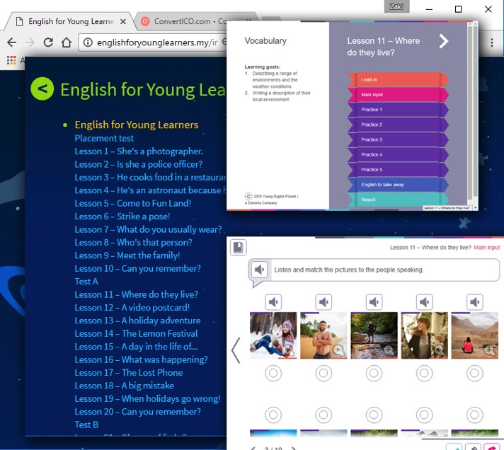
Online Access via web browsers
URL:
http://englishforyounglearners.my
User ID/ Name:
efyl
Password:
efyl2017

Slide 11

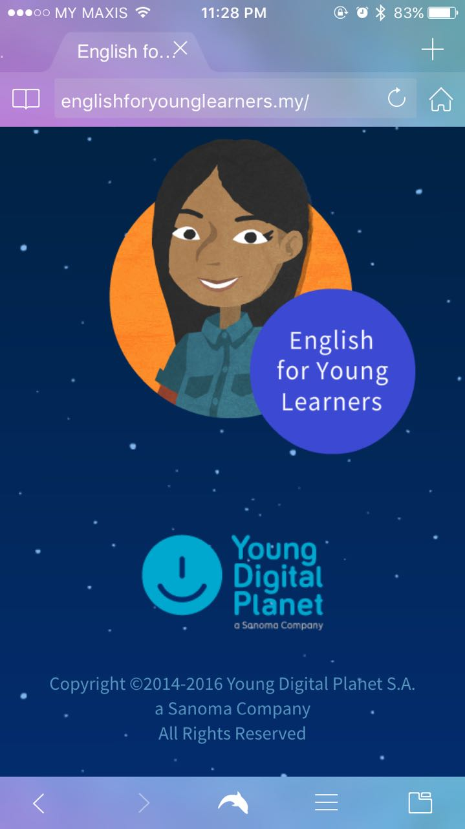
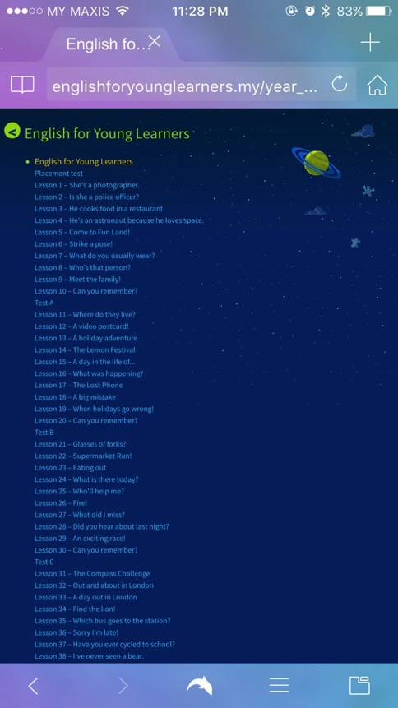
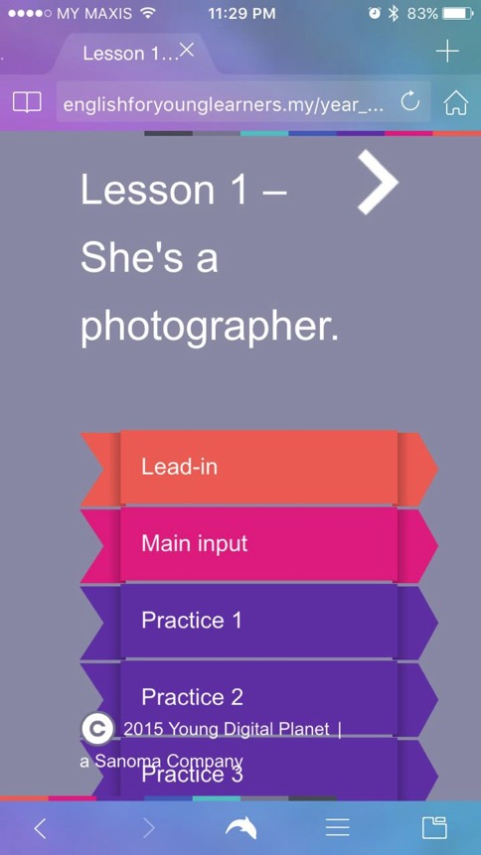
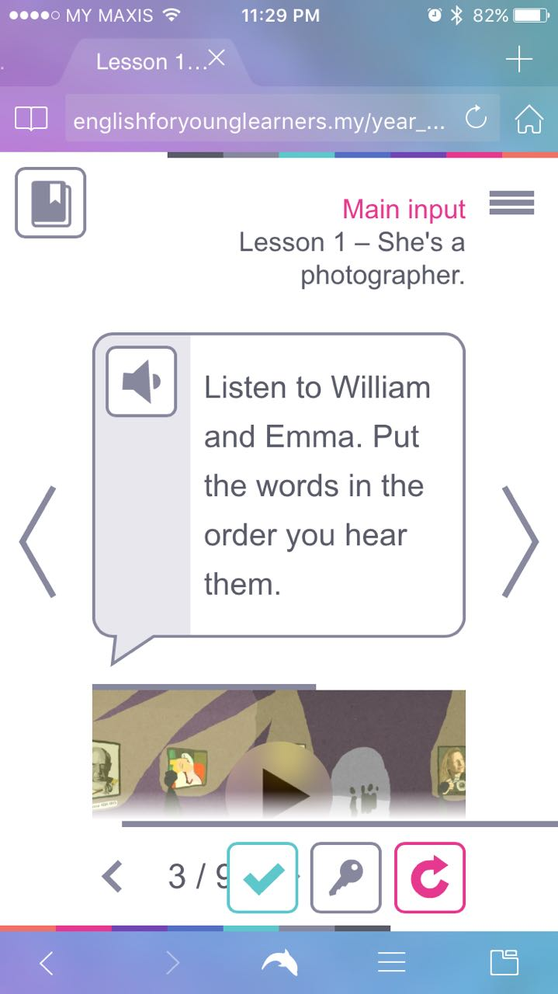
Q: Can I run the online content on a mobile device?

Slide 12
Let’s explore the CD

Slide 13
Lesson Structure
Table of contents – a clear table of contents including all sections covered in the lesson. Each element is clickable
Presentation (Main Input) – screens with theory presented in the form of animations/ slideshows
Practice – screens with activities consolidating knowledge (cloze, connection, labelling, ordering, choice…)

Slide 14
Lesson Structure (cont’d)
English to take away – a module that helps students become active and reflective users of English (small chunks of language including short phrases, dialogues, simulations and games that students can practise with peers, parents and teachers)
Lesson report – a clear report page presenting the result of all exercises available in the lesson and supplying links to particular screens

Slide 15
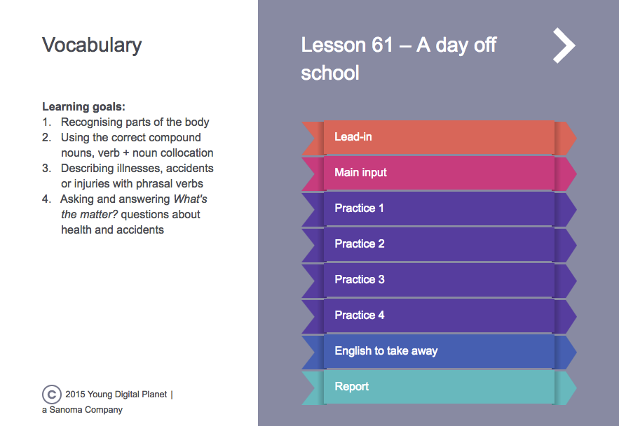
Lesson Structure
Click on the coloured tab

Slide 16
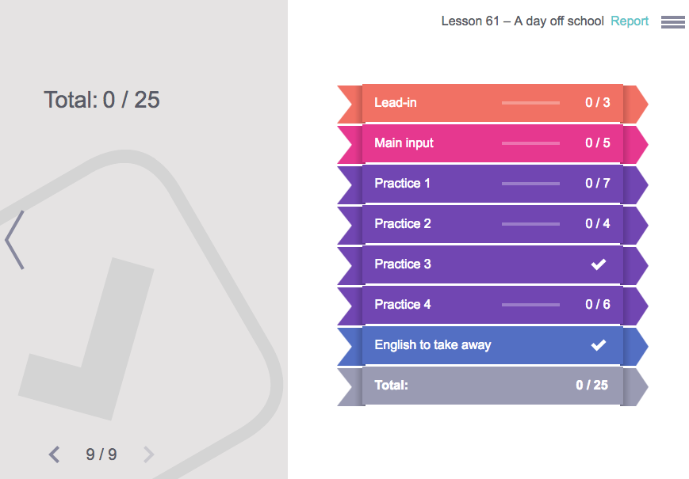
Lesson Structure
The report page shows how you do. The result is instantaneous.

Slide 17
Remember!
Sessions cannot be saved. On a shared machine, the student have to close the program/ browser and start everything all over again.
Therefore, results have to be recorded manually.
Suggested tracking: Get students to chart their results for every lesson and test. A nice chart = better reporting.

Slide 18
Example of Combining lessons from the KSSM F1 Textbook & EFYL
KSSM Textbook:
Chapter 4: Be Wise, Think Twice
Theme: Consumerism & Financial Awareness
Grammar Standards: 4.1.1 (iii) countable nouns, (iv) uncountable nouns)
EFYL Content:
Lesson 22: Supermarket Run!
Function: Shopping
Grammar: Countable & uncountable nouns, determiners and articles (KSSM textbook chapter 1, p.9)

Slide 19
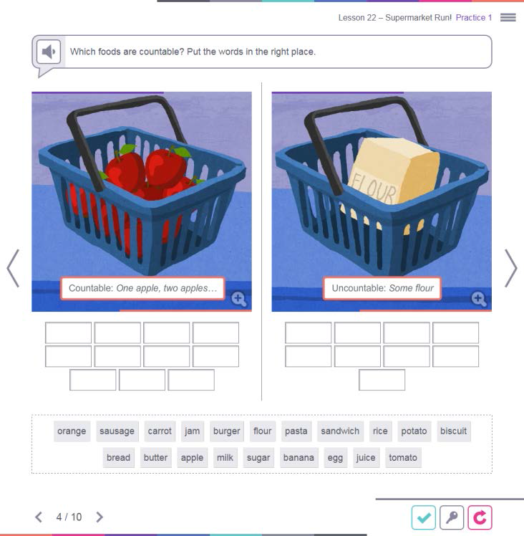
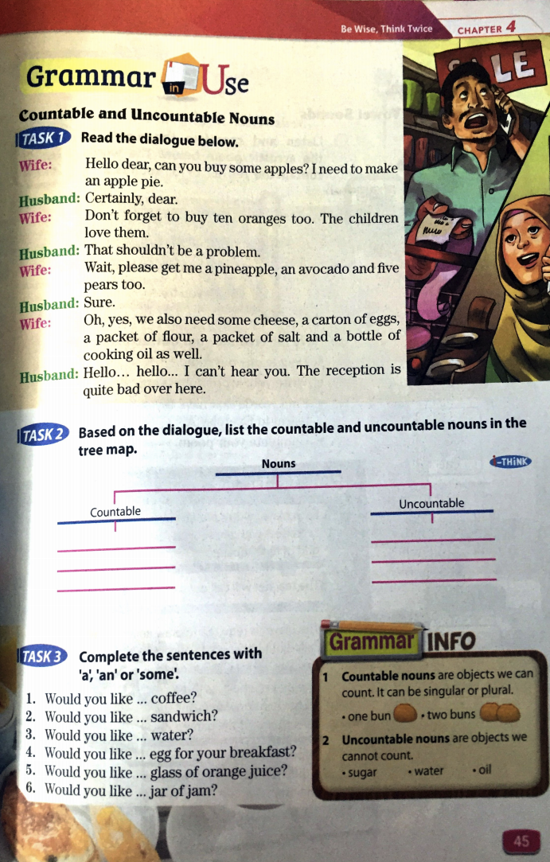
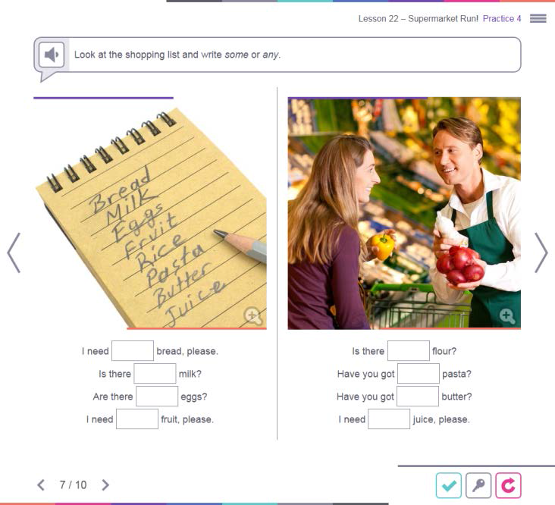

Slide 20
Example of Combining lessons from the KSSM F1 Textbook & EFYL
KSSM Textbook:
Chapter 5: A Bundle of Joy
Theme: People & Culture
Content: Learning about different cultures and various celebrations
EFYL Content:
Lesson 41 – 44
Content: Talk about celebrations, festivals, past experiences…

Slide 21
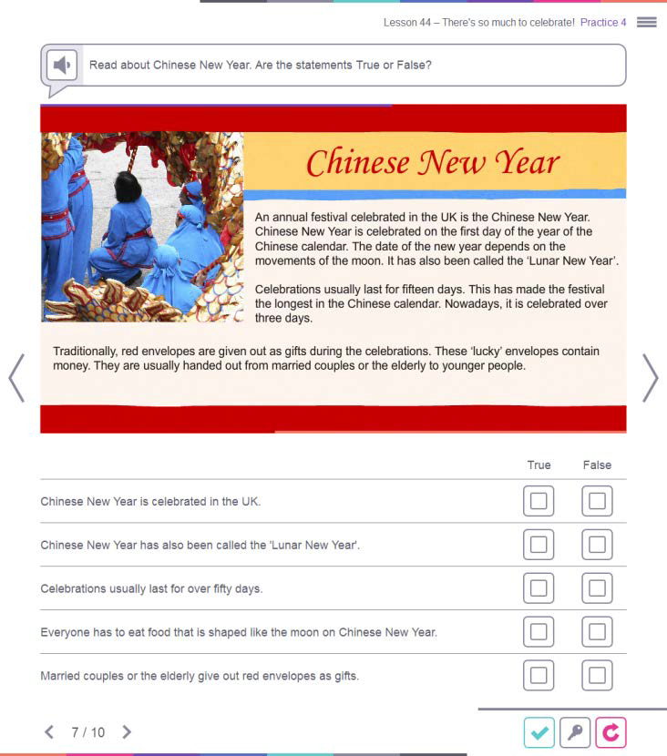
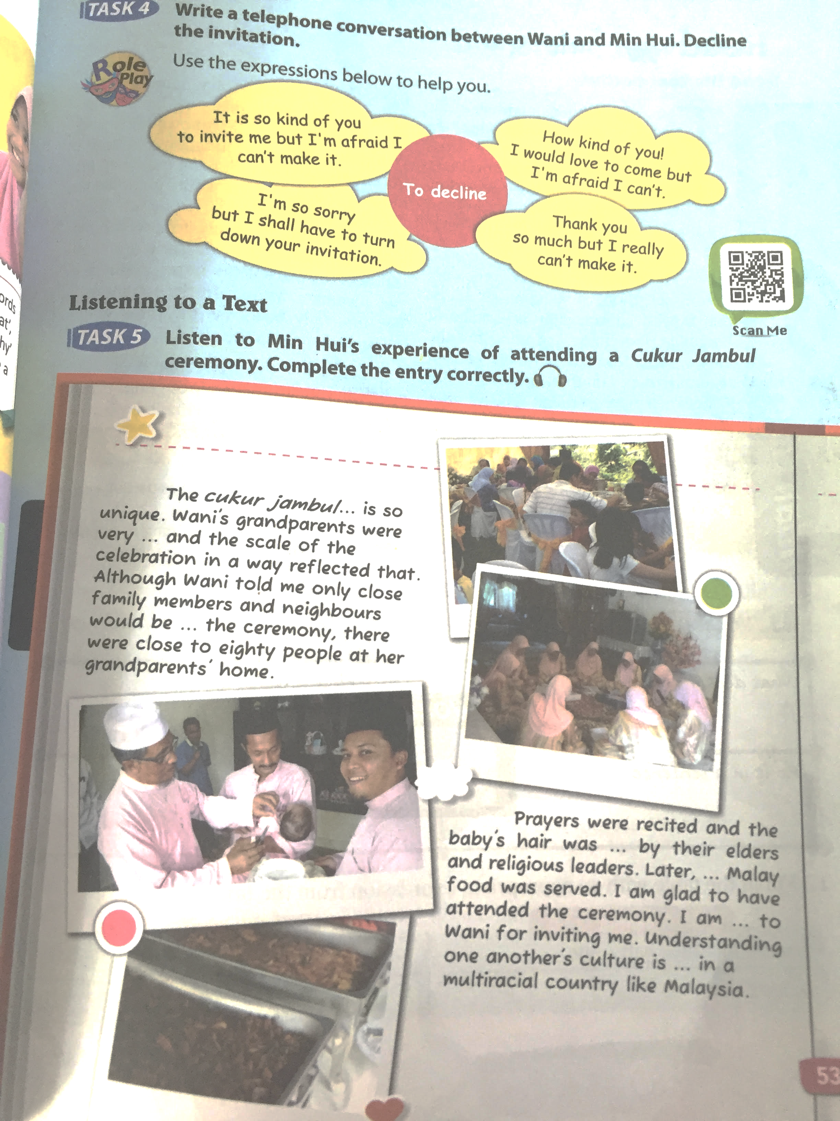

Slide 22
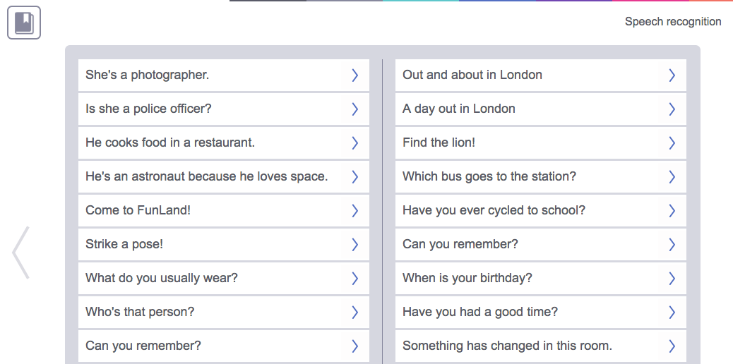
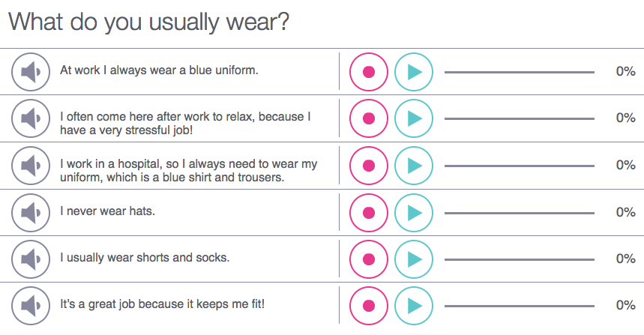
Speech Recognition
1. Click on the title. A popup screen will appear.
4. Once processing is done, your score will be displayed instantaneously.
2. Click the speaker icon to listen to the sentence.
3. Click the record button to record own voice. Try to match the tone and timing.
Click on the play button to listen to own recorded voice.

Slide 23
That’s all, folks! Thank you!
Happy teaching :D

